Slide 1
Office of Informatics and Analytics (OIA) Strategic Investment Management (SIM) Business Architecture (BA) Business Information Architecture (BIA) BIA Logical Information Models Conformance to FHIM Patient Generated Data – Blood Pressure and Mental Health Quality
Presented by: BIA Team

Slide 2
Table of Contents
Overview
Background
Methodology
Mobile Applications: PGD – Blood Pressure
Findings
Conclusions and Recommendations
Mental Health Quality and Clinical Outcomes Reporting Services
Findings
Conclusions and Recommendations
Questions and Answers
Q&A

Slide 3
OVERVIEW

Slide 4
Background
Purpose
To compare and analyze similarities and gaps between the logical information model and the Federal Health Information Model (FHIM)
To determine the degree of conformance
Rationale
This analysis is important to understand differences within VHA models and to promote commonality wherever possible to allow for interoperable exchange of information regarding a Veteran’s Electronic Health Record
Conformance to accepted standards will ensure greater interoperability of Health Information Exchanges (HIE) within the VA Enterprise

Slide 5
Background (cont.)
The FHIM is an information model of healthcare data and is intended to coordinate the efforts of partner agencies with the development of Electronic Medical Records, information, and terminology standards.
The BIA team began participating in FHIM meetings in November 2013 to gain a better understanding of its structures and domains

Slide 6
Methodology
The BIA team used logical information models which contains the data dictionary, and a class diagram.
Files were extracted from Rational Software Architect (RSA) and stored in the BIA SharePoint repository
The data dictionary contains:
Classes
Class documentation
Attributes
Data Types
Multiplicity
Attribute Documentation
The FHIM was search for all information elements.
Domains for each information element were recorded in a conformance matrix.
Each class and attribute in the information model was searched for in the FHIM to identify whether or not the class exists

Slide 7
MOBILE APPLICATIONS: PGD – BLOOD PRESSURE

Slide 8
Findings
The Mobile Applications: PGD – Blood Pressure information model consists of 26 classes, 115 attributes, and 6 domains
13 classes and 48 attributes have corresponding classes/attributes in the FHIM
There are 4 classes: Address, Device, Provenance, and VitalSignObservation which fully conformed to the FHIM
Many attributes in the FHIM were found to be named slightly different than those in the PGD LIM
There were some classes that did not exist in the FHIM and some attributes were found in different classes in the FHIM
There was a combination of 9 classes and 21 attributes that conform to the FHIM, 3 classes and 27 attributes conform partially, and 14 classes and 67 attributes do not conform.

Slide 9
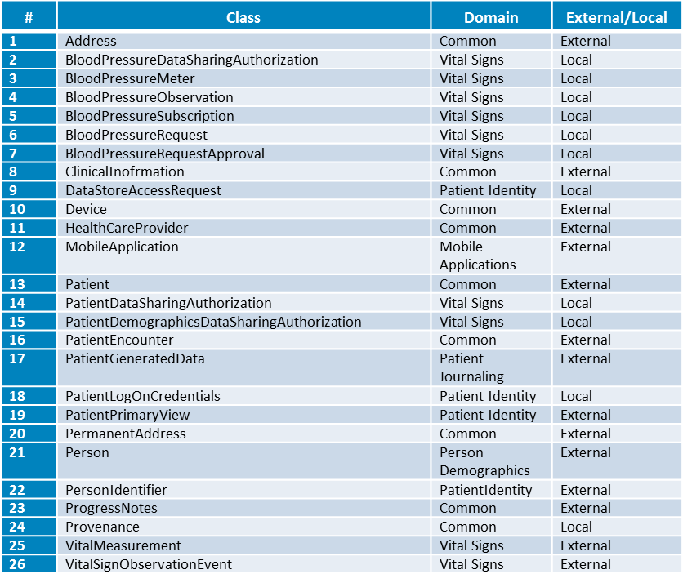
Classes of Mobile Applications: PGD – Blood Pressure

Slide 10
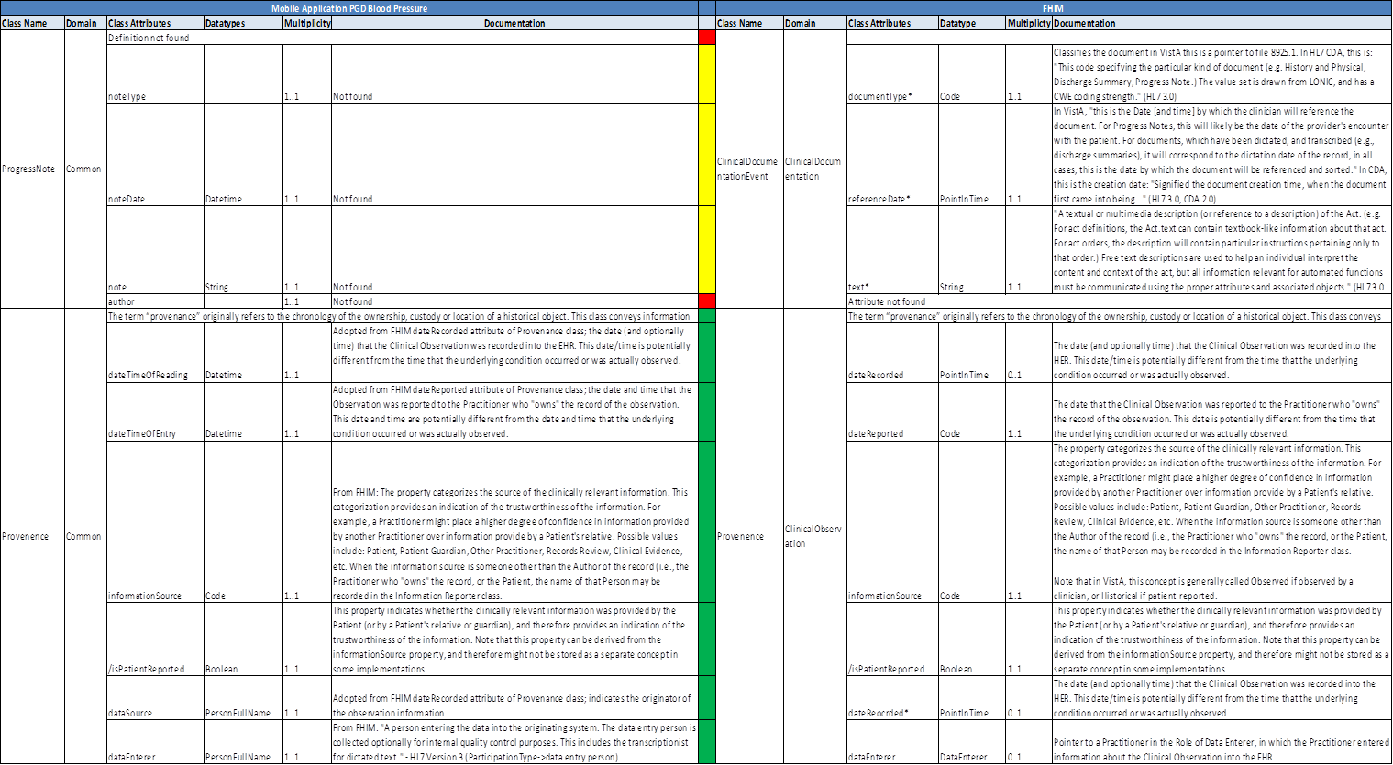
Findings (continued)

Slide 11
Conclusions and Recommendations
Based on the analysis, the BIA team concluded that the Mobile Applications: PGD – Blood Pressure information model partially conforms to the FHIM
It has not yet been determined whether the model conforms to other standards such as the Federal Health Interoperability Resources (FHIR)
The BIA team recommends that a similar analysis should be conducted against the FHIR or other standards
The BIA team also recommends that a similar conformance analysis be conducted for other information models

Slide 12
MENTAL HEALTH QUALITY AND CLINICAL OUTCOMES REPORTING SYSTEM

Slide 13
Findings
The BIA team conducted a similar conformance analysis to the FHIM for Mental Health Quality and Clinical Outcomes Reporting System (MHQ&COR).
The MHQ&COR information model contains:
87 classes total
21 of which are local classes
66 are external classes
921 attributes with some being enumerations.

Slide 14
Findings (cont.)
It has been found that the local classes and attributes in the MHQ&COR information model sampled against the FHIM do not show conformance.
As for external classes, there are:
8 classes and 28 attributes that conform the FHIM
3 classes and 4 attributes that conform partially, and
55 classes and 540 attributes that do not conform to the FHIM

Slide 15
Conclusions and Recommendations
The MHQ&COR information model shows that a majority of local classes and attributes do not conform to the FHIM.
There is a small percentage of external classes and attributes that do conform or partially conform to the FHIM.
It is possible that these classes have not been modeled for the FHIM yet or is still in progress.
A discussion should be held within the BIA team to determine which classes and attributes could be introduced to the FHIM for inclusion into the framework for use in other models.

Slide 16

Q & A
Notes:
Do we always create all models and Artifact mentioned above?
Can we take Mobile App as an example to understand?

